Slide 1
Теория Информации
В.Н. Ярмолик
Лекция 20
2016

Slide 2
Zero-Knowledge Proof Main definitions
A know the value of p and q, where n = pq.
How does A proceed to convince B without revealing the factorization? In other words, is it possible for A to prove to B the assertion that it has knowledge of the factorization of n without yielding anything beyond the validity of the assertion?
Example. The proof n = 670592745 = 12345×54321 is not a zero-knowledge proof that n is not a prime.
Informally. A zero-knowledge proof is an interactive proof protocol that provides highly convincing evidence that a statement is true or that Prover has certain knowledge (of a secret) and that Prover knows a (standard) proof of it while providing not a single bit of information about the proof (knowledge or secret). (In particular, Verifier who got convinced about the correctness of a statement cannot convince the third person about that.)

Slide 3
Zero-Knowledge Proof Main definitions
More formally A zero-knowledge proof of a theorem T is an interactive two party protocol, in which Prover is able to convince Verifier who follows the same protocol, by the overwhelming statistical evidence, that T is true, if T is indeed true, but no Prover is not able to convince Verifier that T is true, if this is not so. In additions, during interactions, Prover does not reveal to Verifier any other information, except whether T is true or not. Consequently, whatever Verifier can do after he gets convinced, he can do just believing that T is true.
Similar arguments hold for the case Prover possesses a secret.

Slide 4
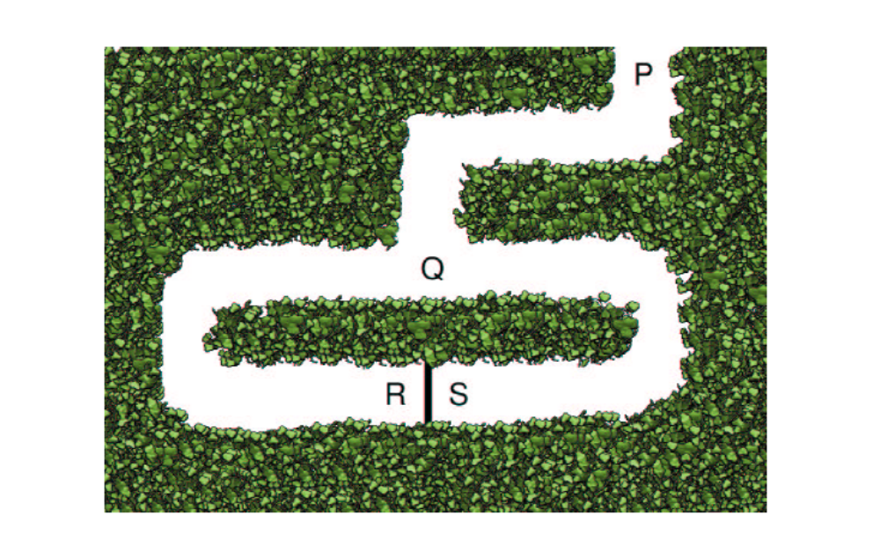

Zero-Knowledge Proof Main definitions

Slide 5
Zero-Knowledge Proof Feige-Fiat-Shamir Identification Protocol
Feige-Fiat-Shamir Identification Protocol
In the following protocol, a prover A, who wants to prove knowledge of secret S_{A} to a verifier B. Also, the acronym TTP will mean a Trusted Third Party.
Setup stage:
1. In the scheme, TTP published a module n which is the product of two large primes p and q of the form 4r+3 for which the x² mod n has solutions. Also, a parameter α∈N is chosen.
2. A and B select, respectively, a secret S_{A}, S_{B} ≤ n-1. Then T_{A}=S_{A}² (mod n), and T_{B}=S_{B}² (mod n), are computed for A and B, respectively by the TTP. They then register T_{A}, and T_{B} with the TTP as publics keys.

Slide 6
Zero-Knowledge Proof Feige-Fiat-Shamir Identification Protocol
Zero-Knowledge Proof Protocol:
1. A selects an m∈N, called a commitment such that m≤ n-1 and sends w=m² mod n, called the witness, to B.
2. B chooses c∈{0,1}, called a challenge, and sends it to A.
3. A computes r=mS_{A}^{c}(mod n), called the response, and sends it to B.
4. B computes r²(mod n). If r²=wT_{A}^{c}(mod n), then reset α’s value to α-1 and go to step 1 if α>0. If α=0, then terminate the protocol with B accepting the proof. If r²≠ wT_{A}^{c}(mod n), then terminate the protocol with B rejecting the proof.

Slide 7
Zero-Knowledge Proof Feige-Fiat-Shamir Identification Protocol
Suppose that an enemy E tries to impersonate A. Then E could to cheat by selecting any m≤ n-1 and sending the witness w=m² mod n, to B. If B then sends the challenge c=0, E would send the correct answer r=m, which passes step 4. However, if c=1 is sent as a challenge, then E, who does not know the square root S_{A} of T_{A}, cannot respond correctly. Hence, E has a probability 1/2 of escaping detection in the first iteration, 1/4 in the second, and so on. To diminish this kind of arbitrary cheating, to an acceptably small probability of 2^{-α} one performs iterations of the protocol for sufficiently high value of α. Thus, the Feige-Fiat-Shamir Protocol is a Zero-Knowledge Proof of Knowledge of a modular square root of T_{A}, namely the secret S_{A}.

Slide 8
Zero-Knowledge Proof Main definitions
Zero-Knowledge Proof
Motivation for the topics in this section may be derived from the age-old cryptography problem of supplying mutually mistrustful entities with a means of interchanging messages, where each entity desires to reveal as little as possible about its own secrets.
Very informally. An interactive “proof'' protocol at which a Prover tries to convinces a Verifier about the truth of a statement, or about possession of a knowledge, is called “zero-knowledge” protocol if the Verifier does not learn from communication anything more except that the statement is true or that Prover has knowledge (secret) she claims to have.
For instance, suppose that entity A wants to convince entity B that it has knowledge of the factorization of an RSA modulus n=pq. It is certainly simple to do this, since A can merely reveal p and q (an instance of what is called a maximum disclosure proof).

Slide 9
Zero-Knowledge Proof Feige-Fiat-Shamir Identification Protocol
Example:
Setup stage:
1. An RSA modulus n=pq=5×7=35 is chosen by the TTP and made public, but the p=5 and q=7 are kept secret. Also, a parameter α=2 is chosen.
2. A select, respectively, a secret S_{A}=11. Then TTP computes for A T_{A}=S_{A}² (mod n)=11² mod 35=16. They then register T_{A}=16 with the TTP as their public keys.

Slide 10
Zero-Knowledge Proof Feige-Fiat-Shamir Identification Protocol
Zero-Knowledge Proof Protocol:
1. A selects an m=3, called a commitment such that m=3≤ n-1=34 and sends w=m² mod n=3² mod 35= 9 called the witness, to B.
2. B chooses c=0 called a challenge, and sends it to A.
3. A computes r=mS_{A}^{c}(mod n)=3×11⁰ mod 35 = 3 called the response, and sends it to B.
4. B computes r²(mod n)=3² mod 35=9. As the result wT_{A}^{c}(mod n)=9×16⁰ mod 35=r²=9, then reset α’s value to α-1=2-1=1 and go to step 1 if α=1>0.

Slide 11
Zero-Knowledge Proof Feige-Fiat-Shamir Identification Protocol
Zero-Knowledge Proof Protocol:
1. A selects an m=23, called a commitment such that m=23≤ n-1=34 and sends w=m² mod n=23² mod 35= 4 called the witness, to B.
2. B chooses c=1 called a challenge, and sends it to A.
3. A computes r=mS_{A}^{c}(mod n)=23×11¹ mod 35 = 8 called the response, and sends it to B.
4. B computes r²(mod n)=8² mod 35=29. As the result wT_{A}^{c}(mod n)=4×16¹ mod 35=29=r²=29, then reset α’s value to α-1=1-1=0. If α=0, then terminate the protocol with B accepting the proof.

Slide 12
Zero-Knowledge Proof Feige-Fiat-Shamir Identification Protocol Generalization
This protocol is representative of a general structure for a larger class of what are called Three-move, Zero-knowledge Protocols. In such protocols, A sends a witness, B replies with a challenge, and A replies with a response. One iteration of these “moves” is called a round. There is a hidden randomization factor built into the protocol when prover A selects a private commitment from some pre-determined set. Then A computes the associated (public) witness. This initial randomness guarantees that the iterations in the protocol are sequential and independent, namely that there is a variation from one protocol round to another. Also, this establishes a set of “questions”, which A lays claim to being able to answer, so naturally A’s subsequent responses are restricted. The given design of the protocol means that only the prover A with knowledge of the secret S_{A} is capable of answering all of the challenges with correct responses, none of which provide information about S_{A}.

Slide 13
Zero-Knowledge Proof Feige-Fiat-Shamir Identification Protocol Generalization
The process by which A determines the set of questions and B chooses the questions, (1)-(2) in the Feige-Fiat-Shamir Protocol for example, is an instance of what is called a Cut and Choose Protocol. This terminology arises from the classic technique for dividing anything fairly between two people, namely A cuts the object (say a piece of fruit) in “half”, and B chooses one of the halves, leaving the other half for A. Also, the process involved in (2)-(3) of Feige-Fiat-Shamir Protocol, given a witness from (1), is an instance of Challenge-Response Protocol. In this type of protocol it is essential, for security reasons, that A responds to at most one challenge for a given witness, and should never reuse a witness.

Slide 14
Zero-Knowledge Proof Feige-Fiat-Shamir Identification Protocol Limitation
The main restriction of the previous algorithm is two requirements for selection the values of the public keys T_{A} and T_{B}.
The values T_{A} and T_{B} have to satisfy to the equation x²=T_{j} mod n.
There is an inverse T_{j}⁻¹ mod n value for T_{j}.
Let us examine the following the case for n=35.
All possible values of T_{j} are {1,4,9,11,14,15,16,21,25,29,30}, It should be mentioned that values T_{j}∈{14,15,21,25,30} have not the inverse values.

Slide 15
Zero-Knowledge Proof Feige-Fiat-Shamir Identification Protocol Extension
An extension of the algorithm is the application by user A of several public as well as secret keys.
Then the user A have to calculate
r=m×(S_{A1}^{c1}× S_{A2}^{c2}× S_{A3}^{c3}× …× S_{Ak}^{ck}) (mod n), based on k secret keys as well as random bit string c1,c2,c3,…,ck called the response, and sends it to B.
The user B calculates
r²(mod n) and w×(T_{A1}^{c1}× T_{A2}^{c2}× T_{A3}^{c3}× …× T_{Ak}^{ck}) (mod n), then makes the comparison
r²(mod n)=w×(T_{A1}^{c1}× T_{A2}^{c2}× T_{A3}^{c3}× …× T_{Ak}^{ck})(mod n).

Slide 16
Zero-Knowledge Proof Guillou-Quisquater Identification Protocol
Let A is a smart card, which have to prove their validity to the verifier B. Identification of the A’s represents the bit string I –public key for the given card. Open parameters are: n=pq, where p and q are secret, and the value V, along with I. Secret value is G, which satisfies to the equality
I×G^{V}=1 mod n
The smart card A have to prove that it knows the meaning of G.
Protocol:
Smart card A generates random integer number r, where 1<r≤n-1. Then calculate
T=r^{V} mod n,
and sends it to B.

Slide 17
Zero-Knowledge Proof Guillou-Quisquater Identification Protocol
Verifier B generates random integer number d, where 1<d≤n-1, and sends it to A.
Smart card A calculates
D=r×G^{d} mod n,
and sends it to verifier B.
Verifier B calculates
T’=D^{V}×I^{d} mod n,
Due to the following relations
T’=D^{V}× I^{d} mod n=(rG^{d})^{V}×I^{d} mod n=r^{V}(I×G^{V})^{d} mod n=r^{V} mod n=T
This equality is true for the case when I×G^{V}=1 mod n.

